Slide 1





TEAM BLACK SQUAD
MICRO-DOPPLER
BASED TARGET CLASSIFICATION
OUR TEAM
ABDUL RIJAS AHAMMED
BALA MUGESH M K
DHARSHINI M V
MAGESHWARAN P
MAHIMA TEJESHWINI R
PRABHA M

Slide 2
PROBLEM STATEMENT
Need for Security: Demand for efficient surveillance systems
Threat:
Privacy and Security risks.
Miscellaneous activities & threats
Objective: Classify drones and birds using micro-Doppler radar data to enhance detection accuracy.

Slide 3
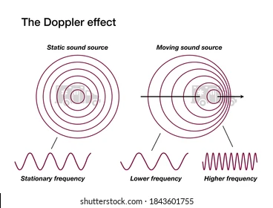
THE SCIENCE BEHIND IT
Doppler Effect:
Change in a wave’s frequency as the source moves closer or farther.

Slide 4
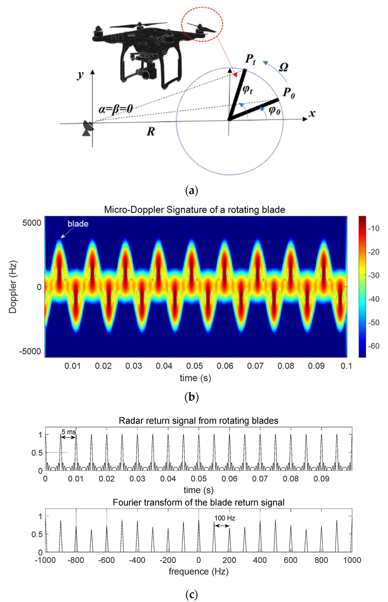
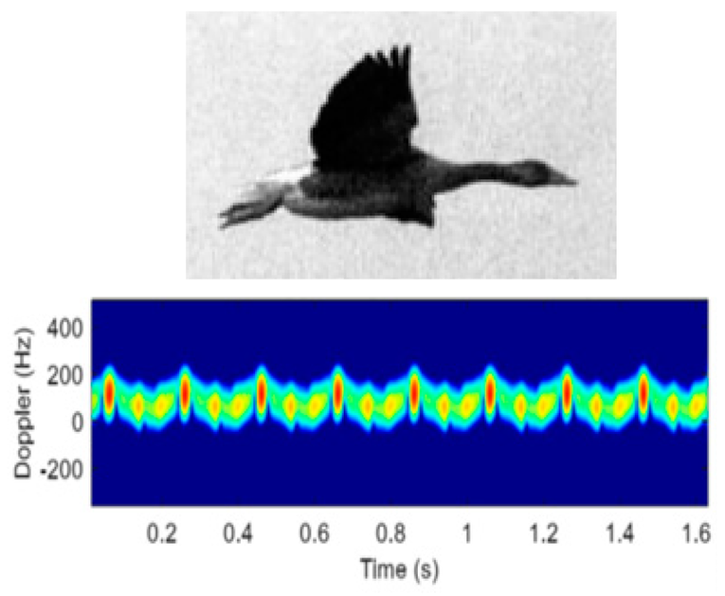
THE SCIENCE BEHIND IT
Micro - Doppler Effect:
Frequency changes from moving object parts like blades or wings.

Slide 5
DATASET:
A 77 GHz FMCW radar dataset with 75868 micro-Doppler segments of drones, birds, humans, and corner reflectors for classification tasks.
Column Details:
Target Type: Type of object (e.g., drones, birds, humans).
Radar Data: Complex-valued matrix of radar measurements.
Range: Distance to the target's center (in meters).
Time: Time position of the radar segment.
Partition: Dataset split (1=training, 2=validation, 3=test).
Edge Indicator: Whether the target is near the radar’s field edge (1=yes, 0=no).
Targets:
Birds - 6
Drones - 6
Source: https://zenodo.org/records/5511912

Slide 6
EXISTING SOLUTIONS
Using Short-Time Fourier Transform(STFT) :
Radar signals are converted into spectrograms by using STFT. These spectrograms help capture the motion patterns of drones and birds, which are then classified using GoogLeNet. and custom Serial Network.
PROOF OF CONCEPT: https://doi.org/10.5281/zenodo.5845259
Using Fast Fourier Transformation:
The radar data is transformed into a frequency spectrum using FFT, it is directly feed to the model after normalization. CNN model processes this data to classify drones versus non-drones.
PROOF OF CONCEPT: https://doi/10.1049/iet-rsn.2019.0493

Slide 7
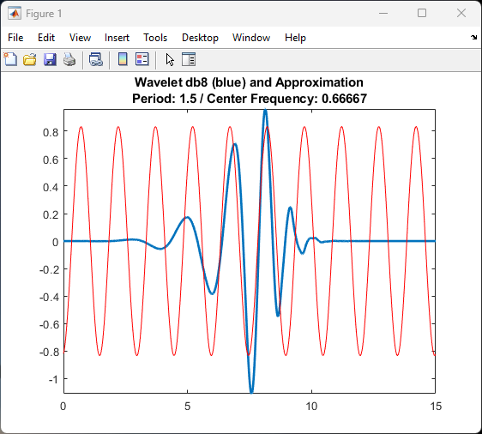
PROPOSED SOLUTION
PROPOSED SOLUTION
Using Continuous Wavelet Transformation(CWT):
We proposed an efficient solution using the CWT with a Random Forest algorithm, where features were extracted from scalogram images to enable object classification within 47 ms and detection in only 70 ms.

Slide 8
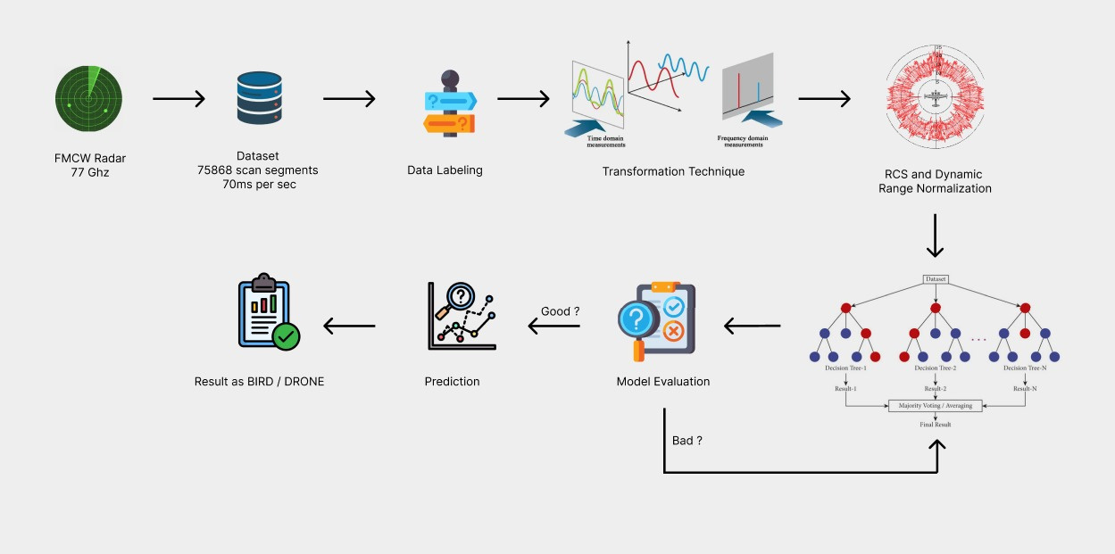
PROPOSED SOLUTION

Slide 9

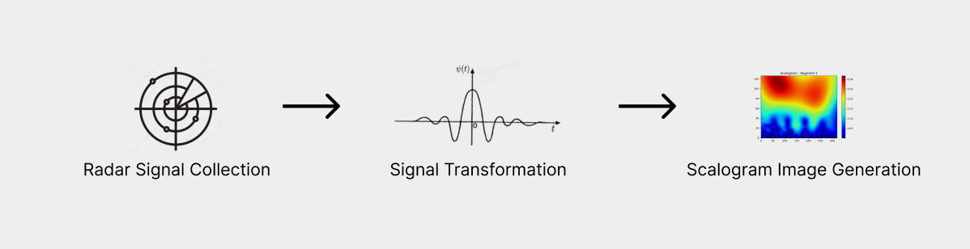
EXPANDING POSSIBILITIES
Wavelet Transformation
A wavelet transform (WT) is the decomposition of a signal into a set of basis functions consisting of contractions, expansions, and translations of a mother function.

Slide 10
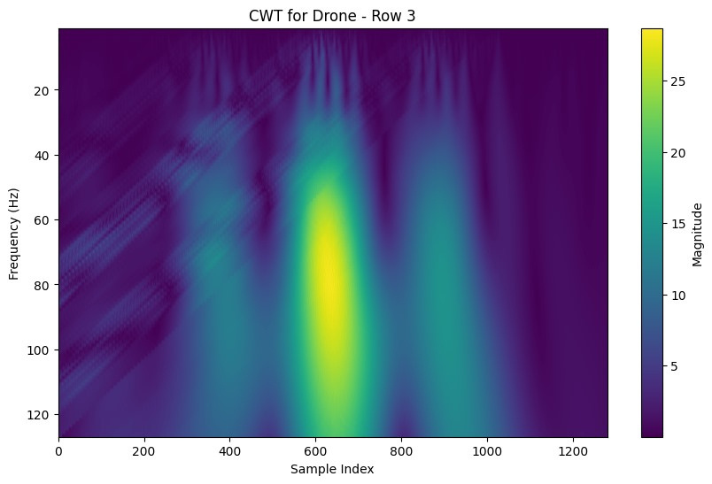
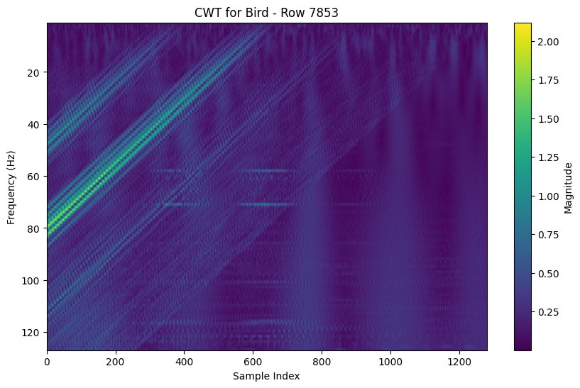
BIRD OR DRONE

Slide 11
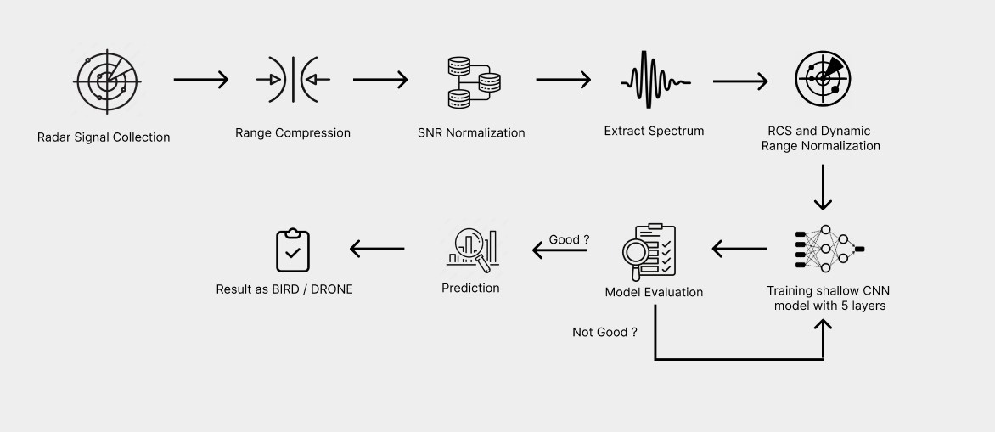
TAKEWAY FROM ROUND 1 - MENTORING SESSION
MULTI-CLASS TARGET CLASSIFICATION IDEA

Slide 12
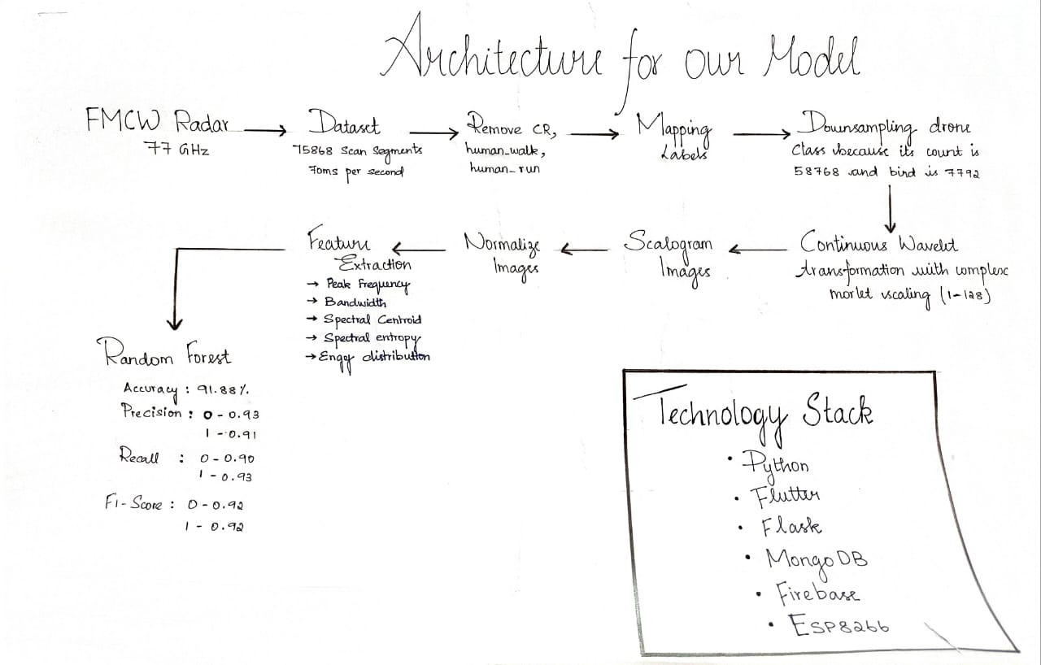

Slide 13
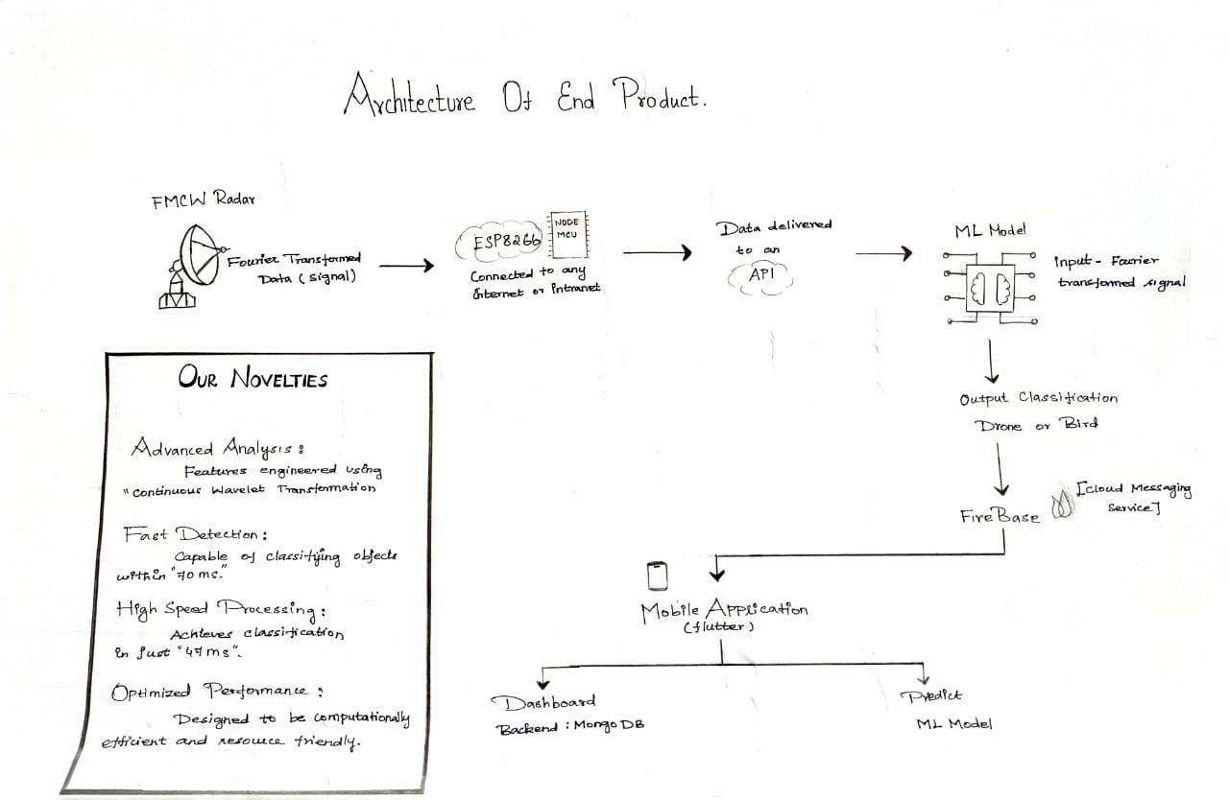

Slide 14

PRIME MINISTER
INPUTS AND UPDATES
==> Distance of target
==> Direction of target

Slide 15
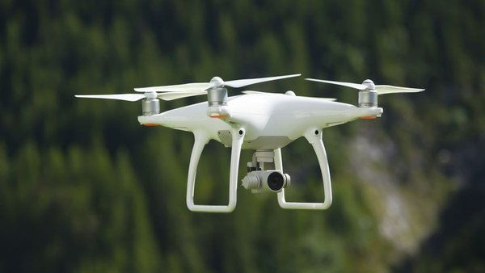
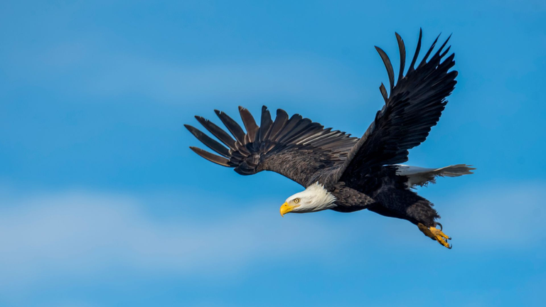
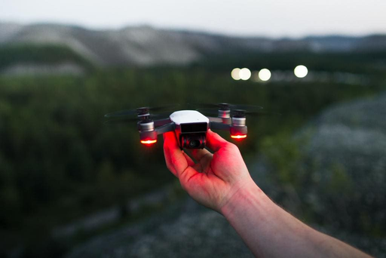
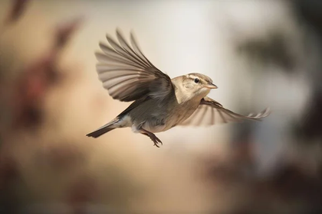
CONCLUSION
Research-driven solution for drone detection and classifications. Combines advanced technologies, scalable, real-world prototype addressing critical security concerns.

Slide 16


REFERENCES
J. Smith and A. Doe, “Micro-Doppler signatures in drone detection,” IEEE Transactions on Aerospace and Electronic Systems, vol. 57, no. 3, pp. 1234–1245, Jul. 2021.
A. Karlsson, M. Jansson and M. Hämäläinen, "Model-Aided Drone Classification Using Convolutional Neural Networks," 2022 IEEE Radar Conference. contact: alek@kth.se
Seongjoon Kang, Henrik Forsten, Vasilii Semkin, Sundeep Rangan, March 15, 2024, "Millimeter Wave 60 GHz Radar Measurements: UAS and Birds ", IEEE Dataport.
S. Björklund and N. Wadströmer, “Target Detection and Classification of Small Drones by Deep Learning on Radar Micro-Doppler,” in *2019 International Radar Conference (RADAR)*, Toulon, France, Sep. 2019, pp. 1–6. doi: 10.1109/RADAR41533.2019.171294.

Slide 17
TEAM BLACK SQUAD
THANK YOU!
As we look to the future, these technologies will play a crucial role in shaping a better world for generations to come.

